Slide 1
Broadband ILD fNIRS Study Update (n=26)
06/07/2024

Slide 2
Since last week
Changed baseline to 5 seconds prior
Mean errorbar plots
Mixed effects model
Change behavior to hit rate

Slide 3
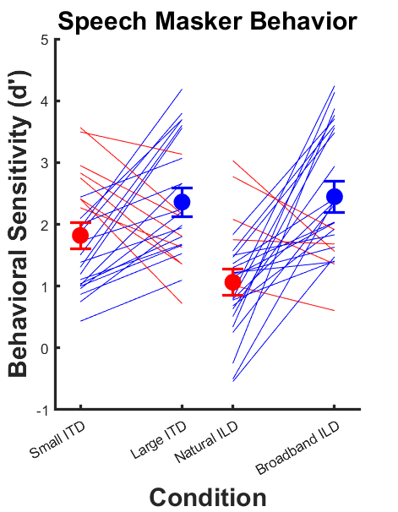
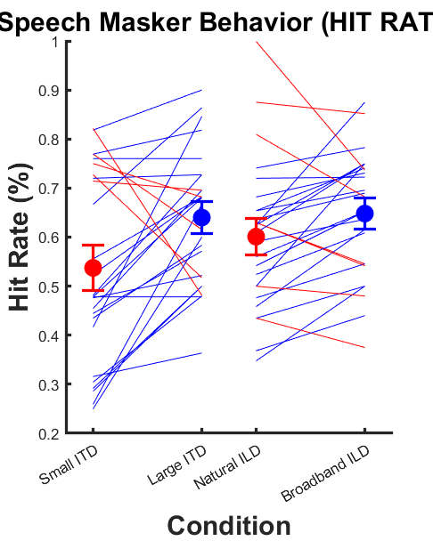
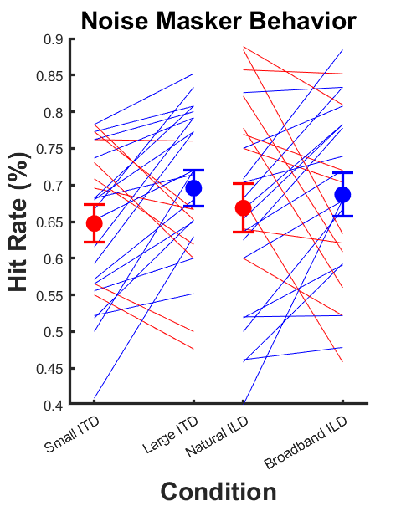
Behavior (n = 26)

Slide 4
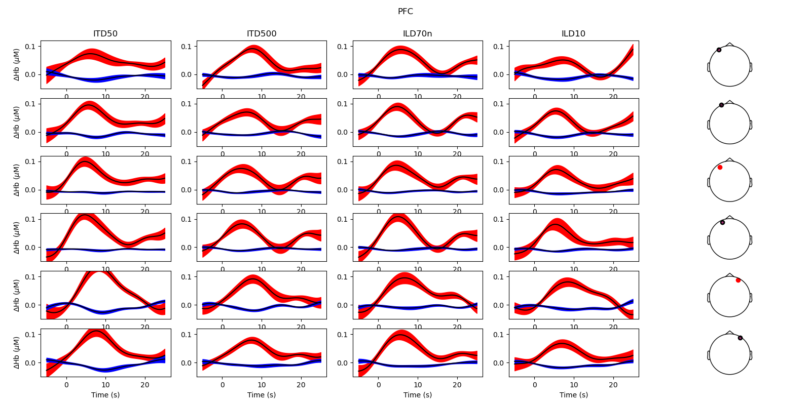
Block averages by channel (PFC): Speech Masker

Slide 5
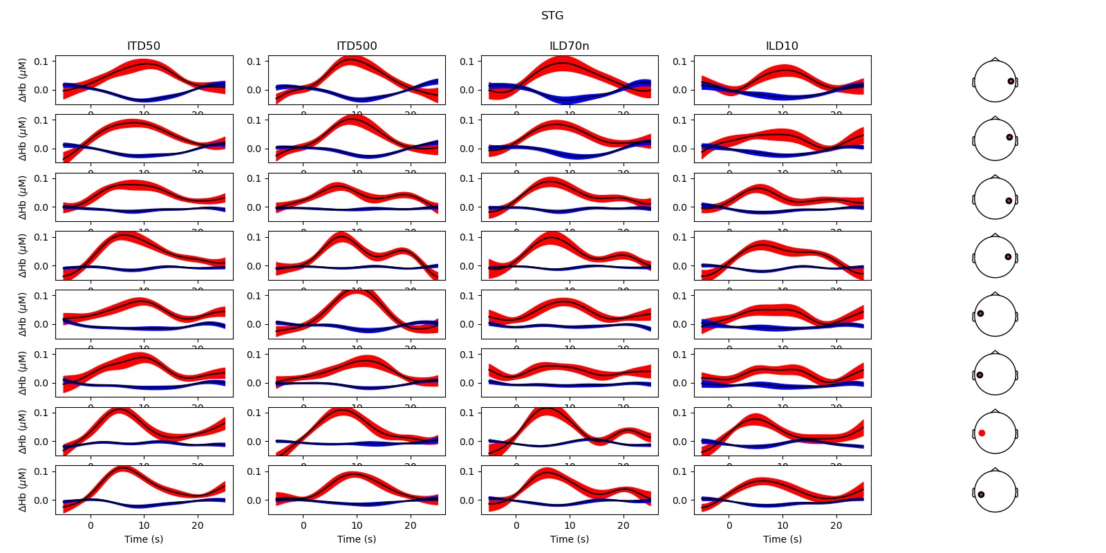
Block averages by channel (STG): Speech Masker

Slide 6
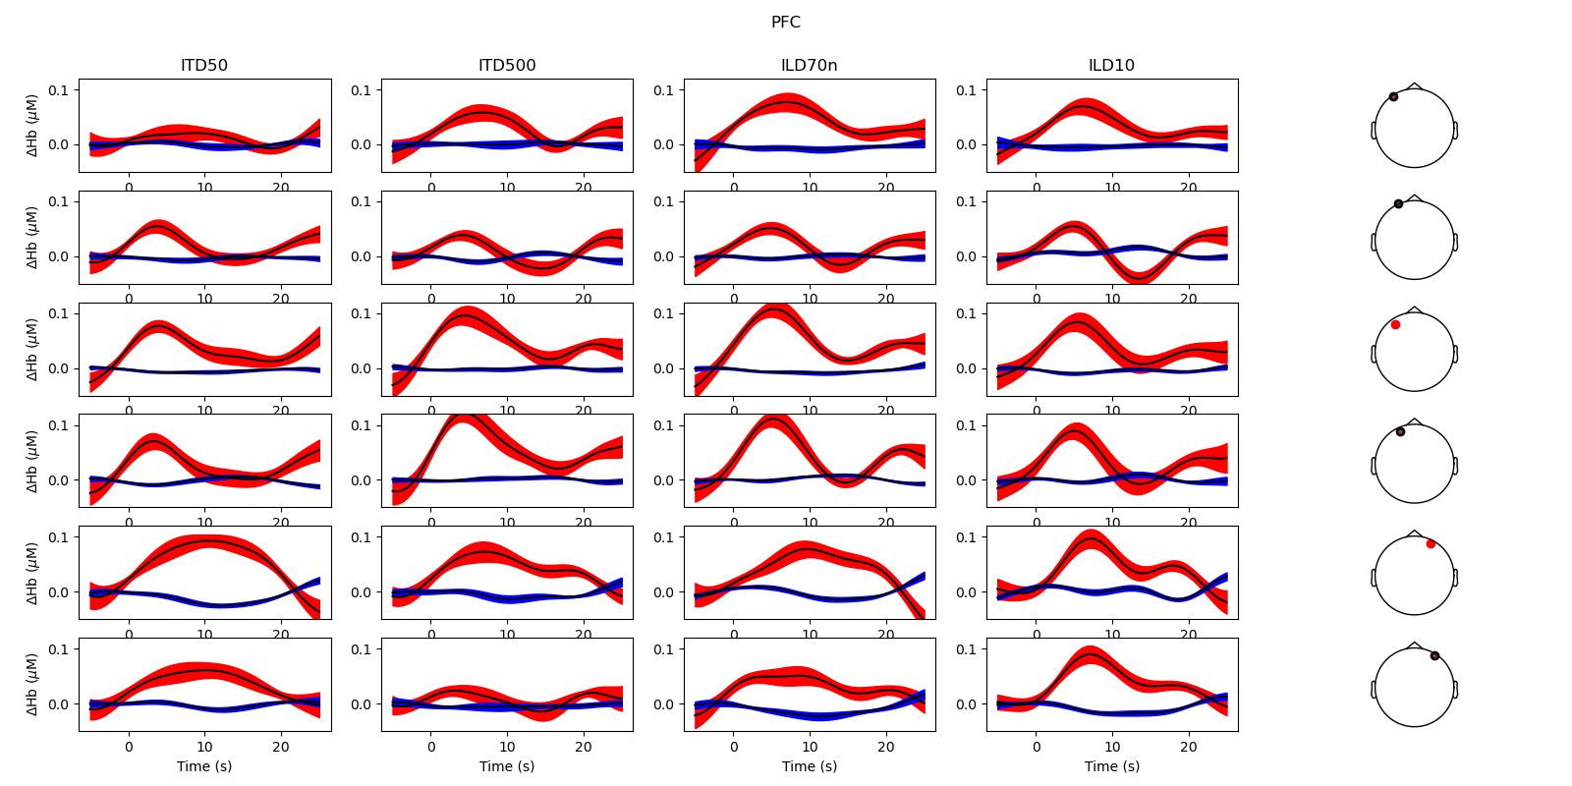
Block averages by channel (PFC): Noise Masker

Slide 7
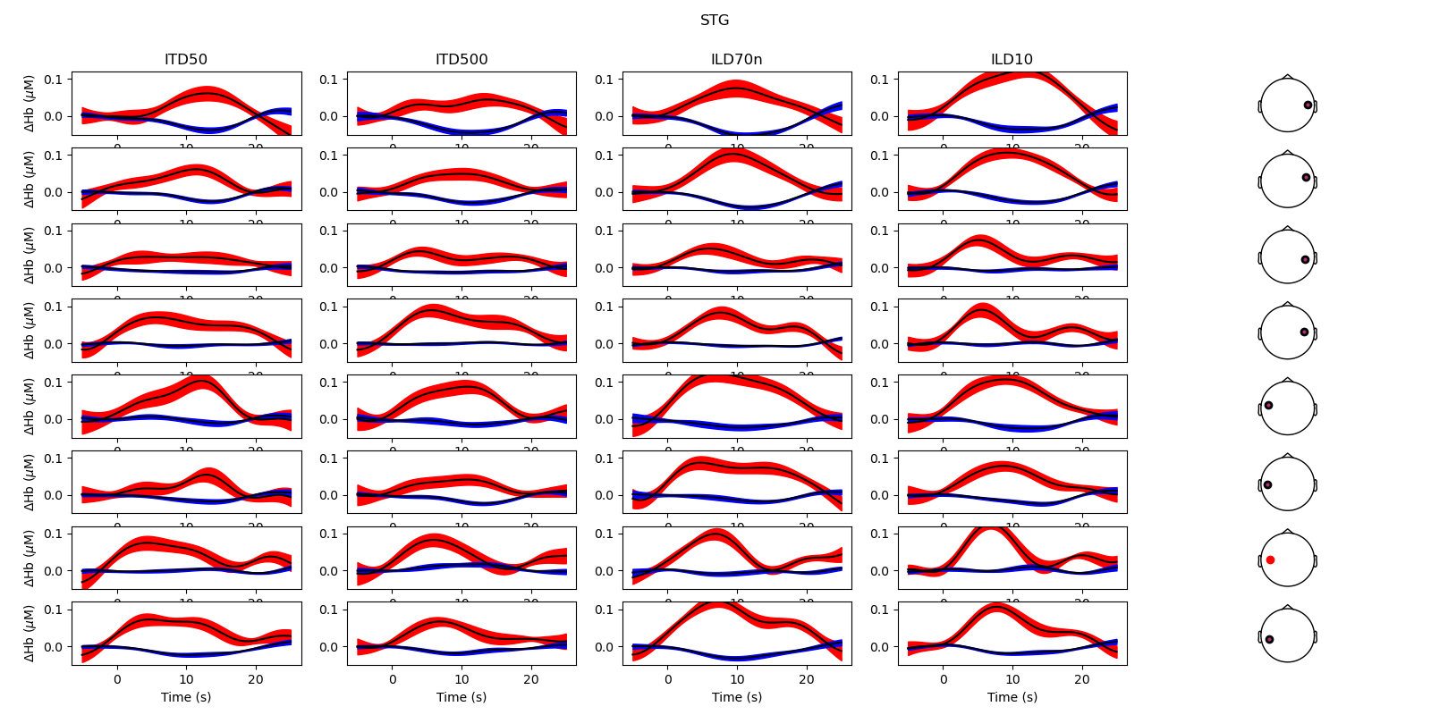
Block averages by channel (STG): Noise Masker

Slide 8
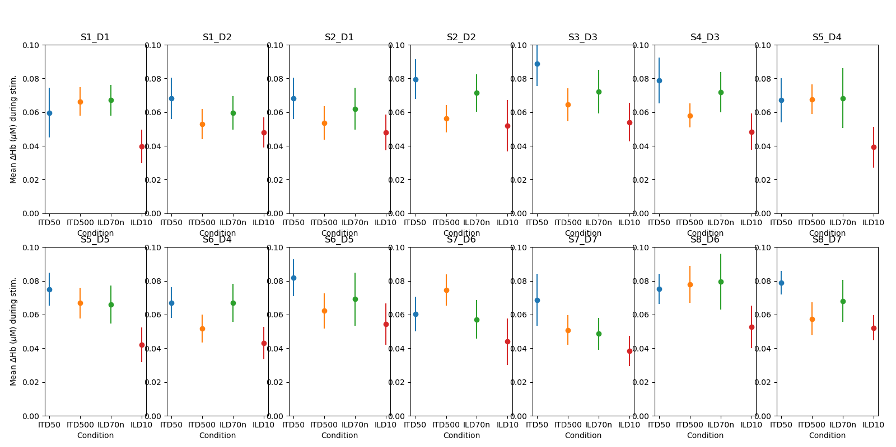
Mean HbO by channel: Speech Masker

Slide 9
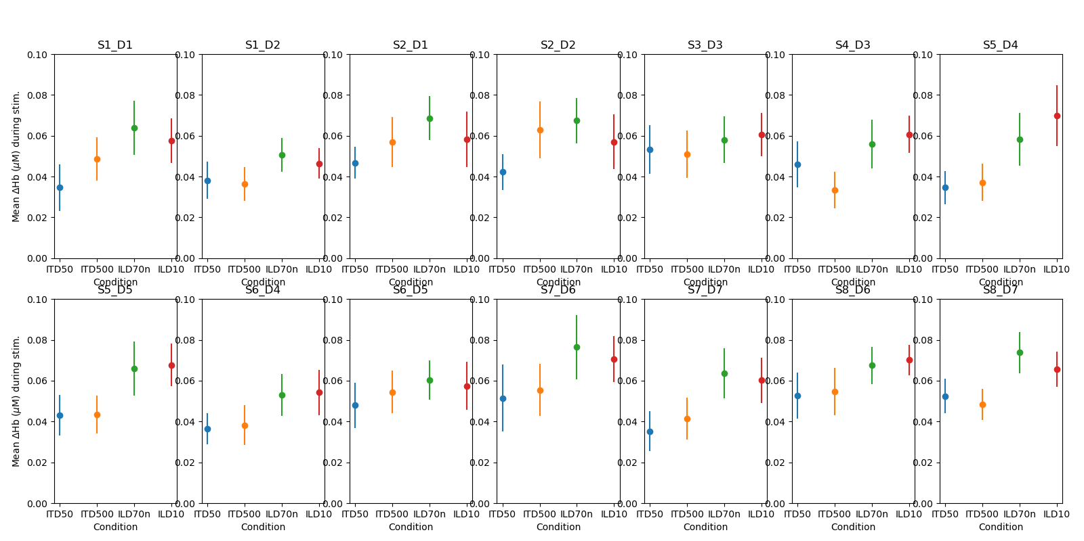
Mean HbO by channel: Noise Masker

Slide 10
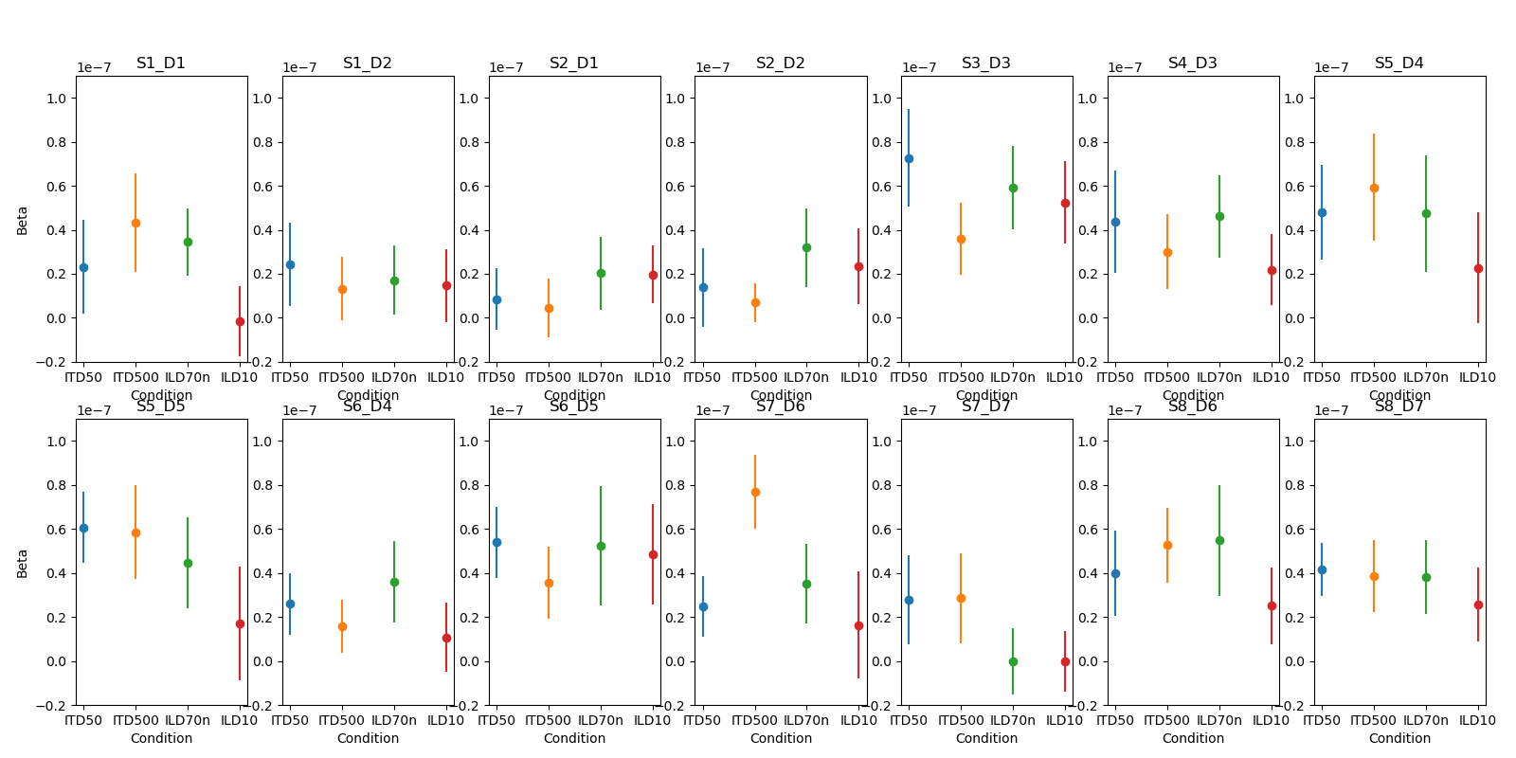
Beta by channel (dur = 12): Speech Masker

Slide 11
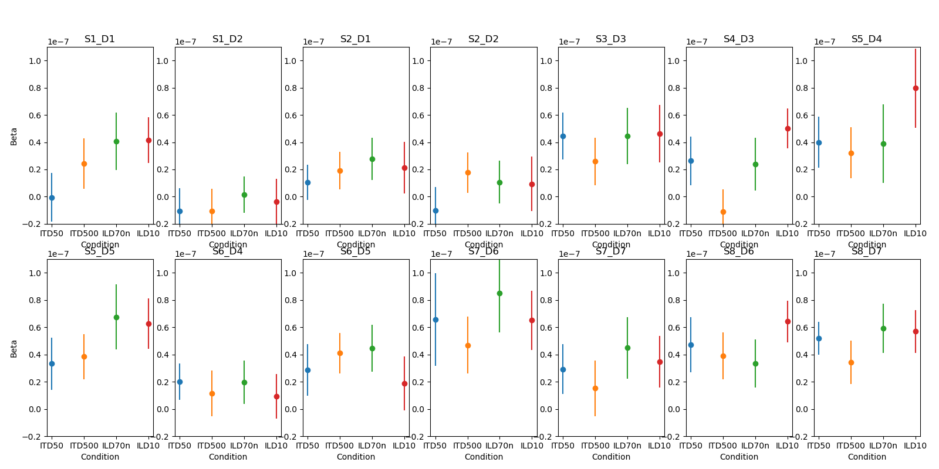
Beta by channel (dur = 12): Noise Masker

Slide 12
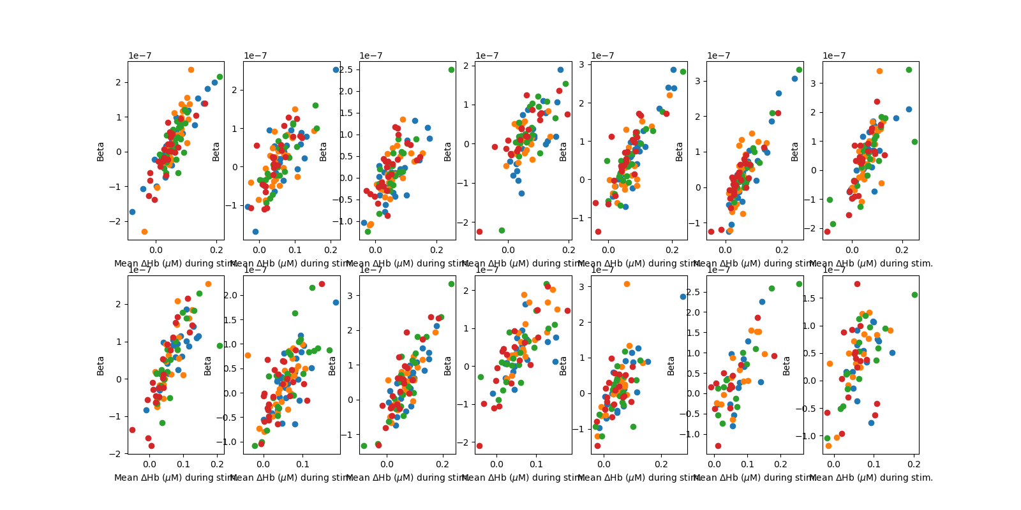
Mean HbO vs. Beta (dur = 12), speech masker

Slide 13
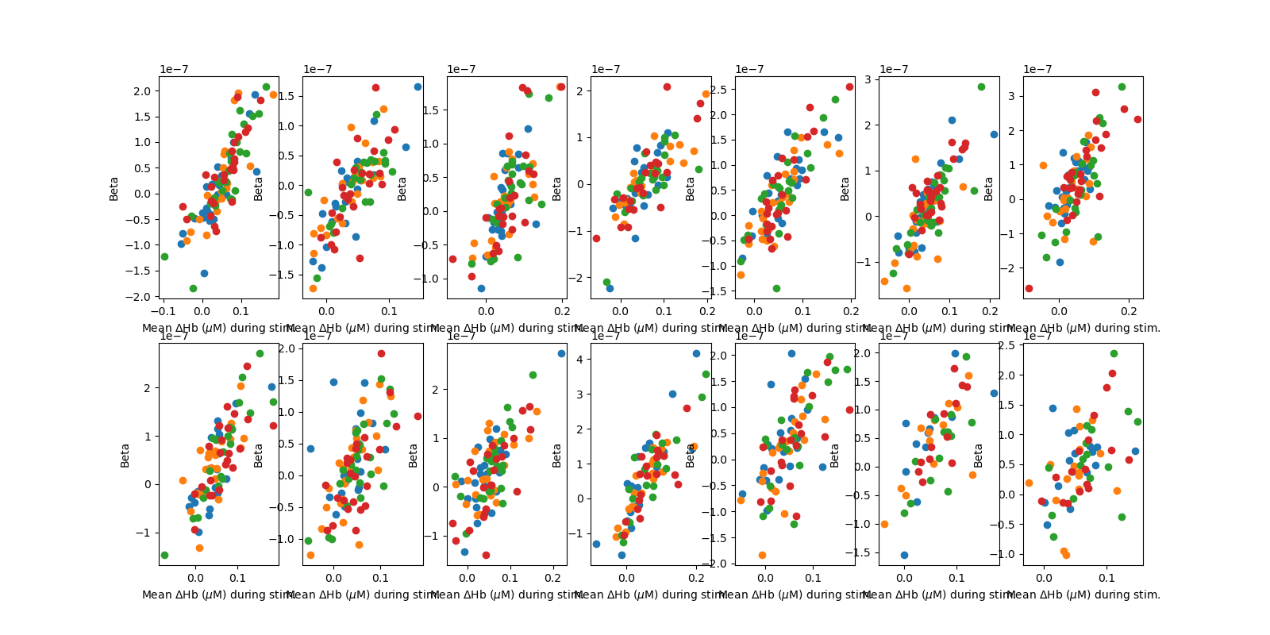
Mean HbO vs. Beta (dur = 12), noise masker

Slide 14
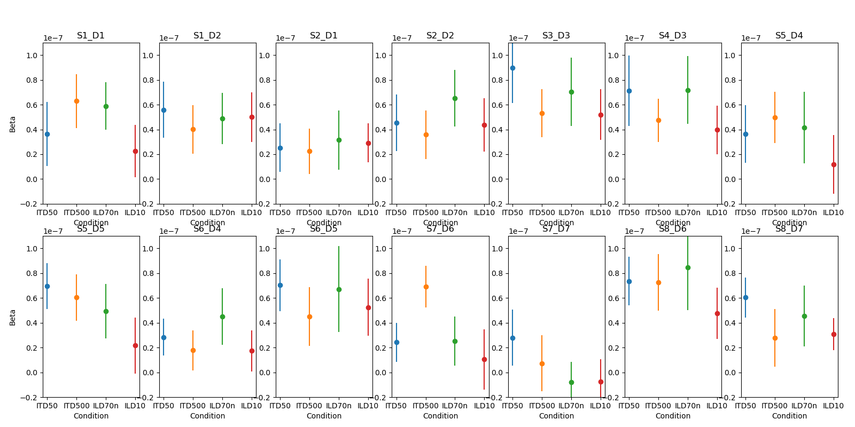
Beta by channel (dur = 7): Speech Masker

Slide 15
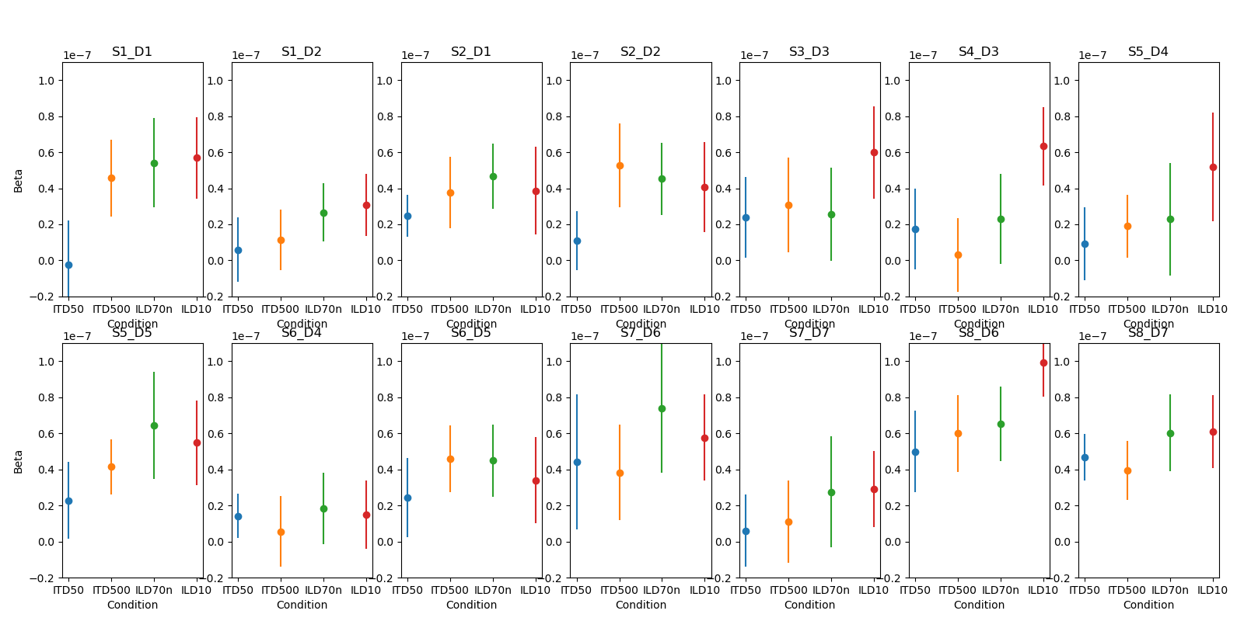
Beta by channel (dur = 7): Noise Masker

Slide 16
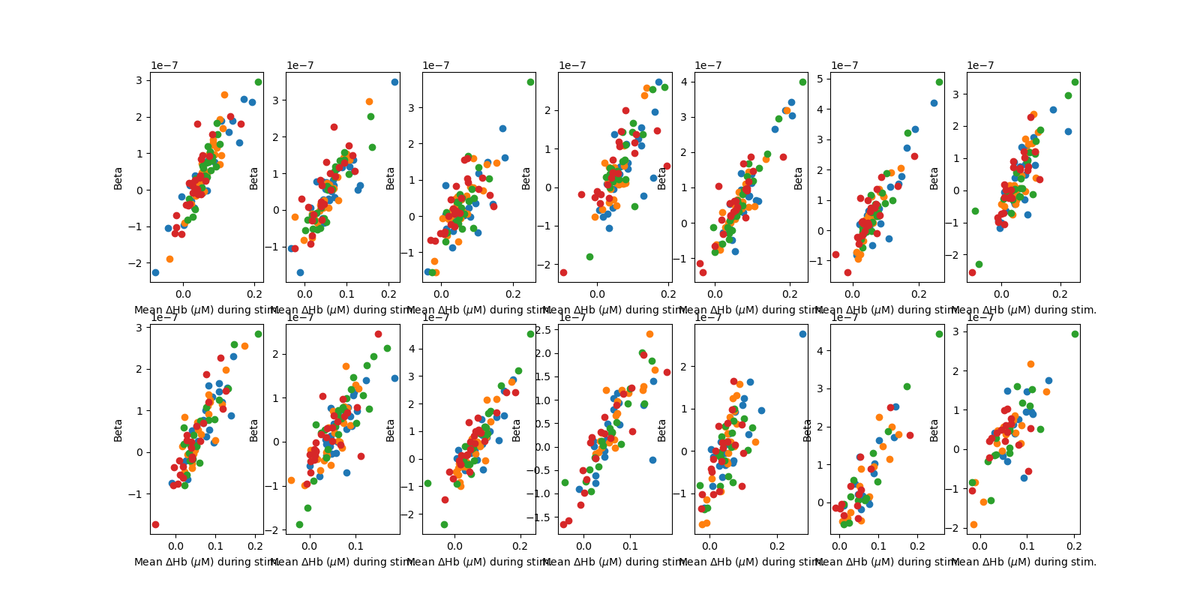
Mean HbO vs. Beta (dur = 7), speech masker

Slide 17
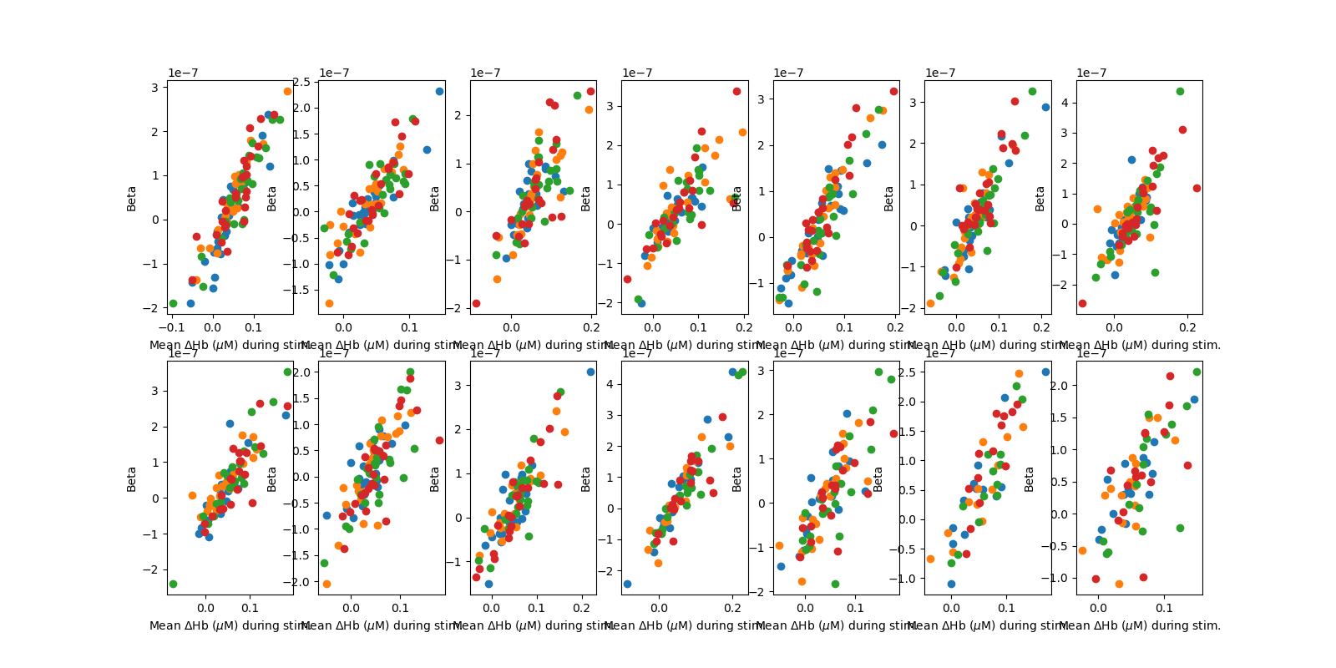
Mean HbO vs. Beta (dur = 7), noise masker

Slide 18
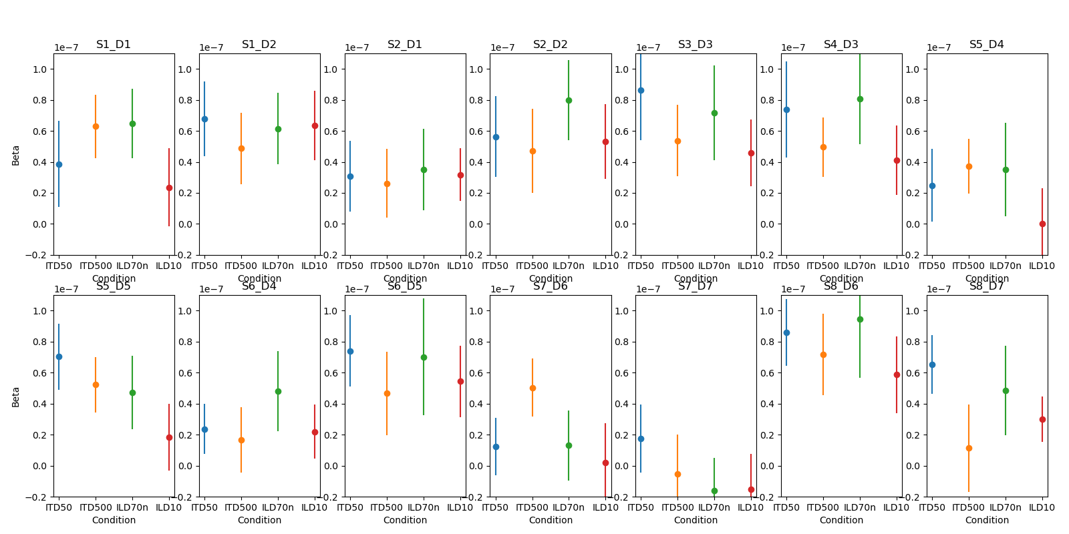
Beta by channel (dur = 5): Speech Masker

Slide 19
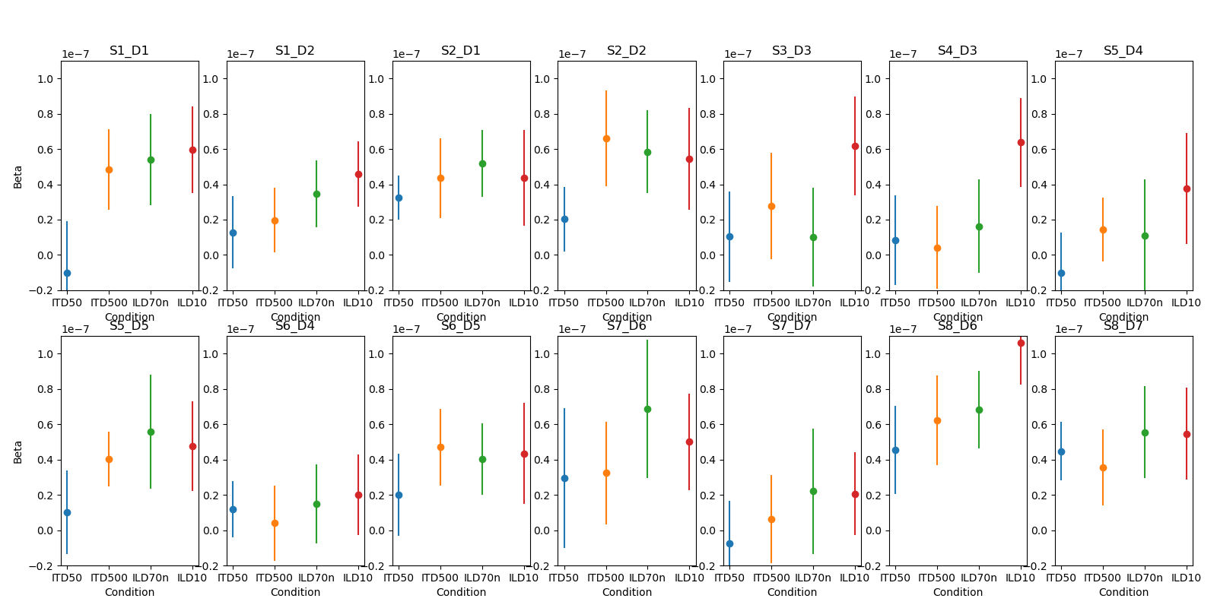
Beta by channel (dur = 5): Noise Masker

Slide 20
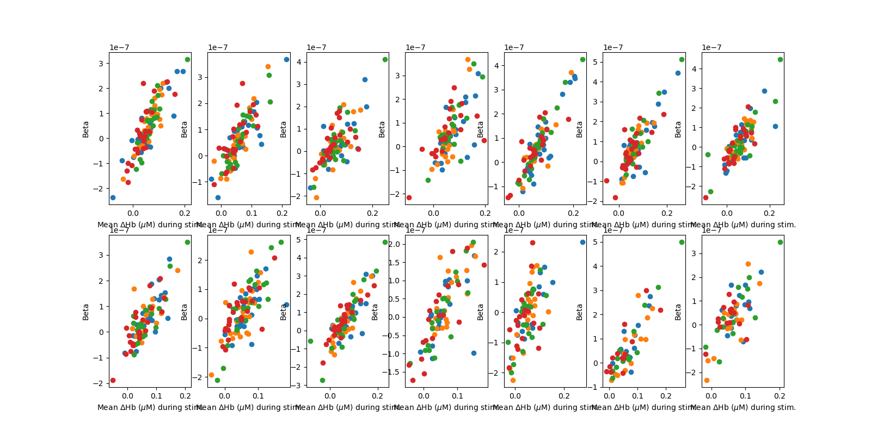
Mean HbO vs. Beta (dur = 5), speech masker

Slide 21
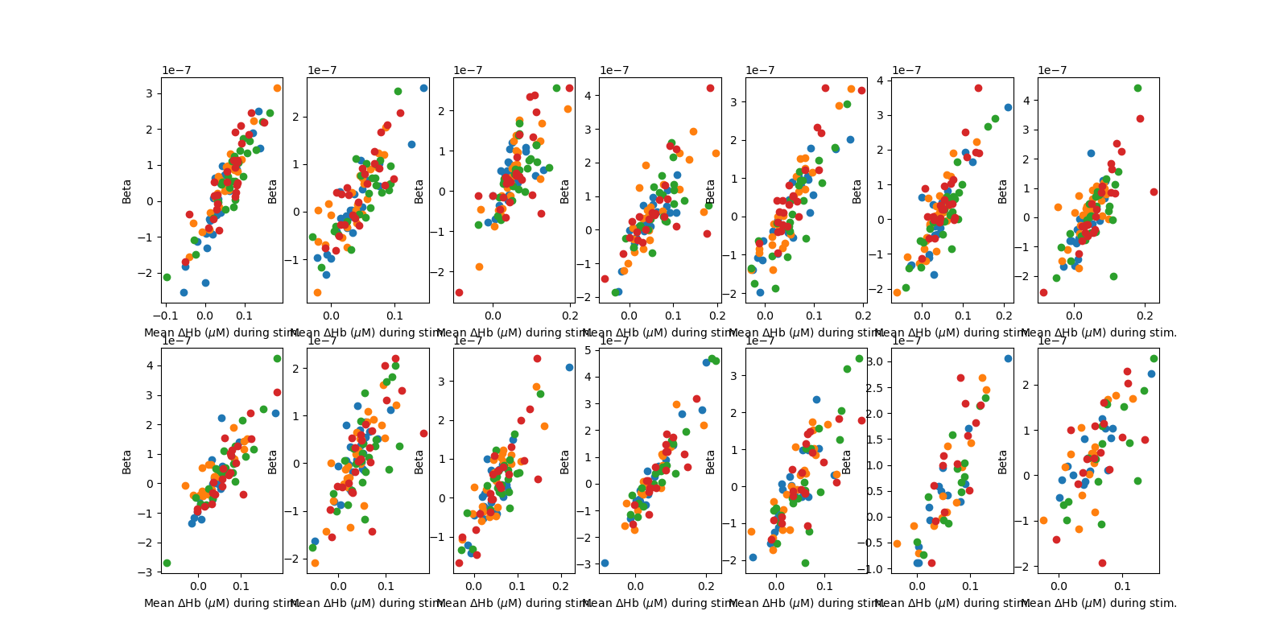
Mean HbO vs. Beta (dur = 5), noise masker

Slide 22
Magnified ILD fNIRS Study Update (n=2)
06/14/2024

